Slide 1
Software design

Slide 2
Software design is a process to transform user requirements into some suitable form, which helps the programmer in software coding and implementation.
It deals with representing the client's requirement, as described in SRS (Software Requirement Specification) document, into a form, i.e., easily implementable using programming language.

Slide 3
The software design phase is the first step in SDLC (Software Design Life Cycle), which moves the concentration from the problem domain to the solution domain
In software design, we consider the system to be a set of components or modules

Slide 4
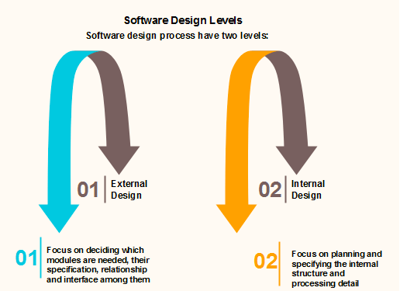

Slide 5
Objectives of Software Design
Correctness
Software design should be correct as per requirement
Completeness
The design should have all components like data structures, modules, and external interfaces, etc.
Efficiency
Resources should be used efficiently by the program

Slide 6
Flexibility
Able to modify on changing needs.
Consistency
There should not be any inconsistency in the design.
Maintainability
The design should be so simple so that it can be easily maintainable by other designers.

Slide 7
Software Design Principle
Software design principles are concerned with providing means to handle the complexity of the design process effectively
Effectively managing the complexity will not only reduce the effort needed for design but can also reduce the scope of introducing errors during design.

Slide 8
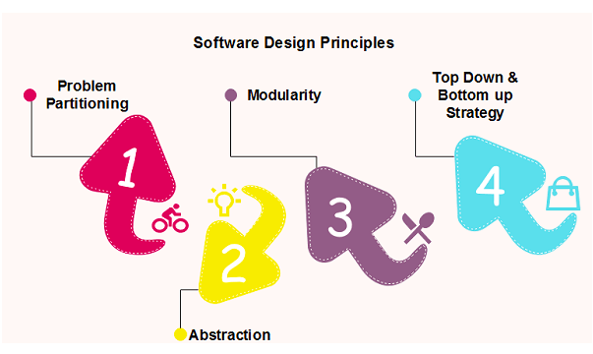

Slide 9
Problem Partitioning
For small problem, we can handle the entire problem at once but for the significant problem, divide the problems and conquer the problem it means to divide the problem into smaller pieces so that each piece can be captured separately
These pieces cannot be entirely independent of each other as they together form the system. They have to cooperate and communicate to solve the problem.

Slide 10
Benefits of Problem Partitioning
Software is easy to understand
Software becomes simple
Software is easy to test
Software is easy to modify
Software is easy to maintain
Software is easy to expand

Slide 11
Abstraction
An abstraction is a tool that enables a designer to consider a component at an abstract level without bothering about the internal details of the implementation.
Two common abstraction mechanisms
Functional Abstraction
Data Abstraction

Slide 12
Functional Abstraction
A module is specified by the method it performs.
The details of the algorithm to accomplish the functions are not visible to the user of the function.
Data Abstraction
Details of the data elements are not visible to the users of data. Data Abstraction forms the basis for Object Oriented design approaches

Slide 13
Modularity
Modularity specifies to the division of software into separate modules which are differently named and addressed and are integrated later on in to obtain the completely functional software.
Single large programs are difficult to understand and read due to a large number of reference variables, control paths, global variables, etc.

Slide 14
properties of a modular system
Each module is a well-defined system that can be used with other applications.
Each module has single specified objectives.
Modules can be separately compiled and saved in the library.
Modules should be easier to use than to build.
Modules are simpler from outside than inside

Slide 15
advantages of Modularity
It allows large programs to be written by several or different people
It encourages the creation of commonly used routines to be placed in the library and used by other programs
It simplifies the overlay procedure of loading a large program into main storagage
it provides more checkpoints to measure progress.

Slide 16
advantages of Modularity
It provides a framework for complete testing, more accessible to test
It produced the well designed and more readable program.

Slide 17
Modular Design
Modular design reduces the design complexity and results in easier and faster implementation by allowing parallel development of various parts of a system

Slide 18
1. Functional Independence
Functional independence is achieved by developing functions that perform only one kind of task and do not excessively interact with other modules.
It makes implementation more accessible and faster.
The independent modules are easier to maintain, test, and reduce error propagation and can be reused in other programs

Slide 19
It is measured using two criteria:
Cohesion
Cohesion is a measure that defines the degree of intra-dependability within elements of a module. The greater the cohesion, the better is the program design.

Slide 20
Coupling
It measures the relative interdependence among modules.
Coupling is a measure that defines the level of inter-dependability among modules of a program.
It tells at what level the modules interfere and interact with each other. The lower the coupling, the better the program.

Slide 21
2. Information hiding
Modules should specify that data included within a module is inaccessible to other modules that do not need for such information.

Slide 22
To design a system, there are two possible approaches:
Top-down Approach
Bottom-up Approach

Slide 23
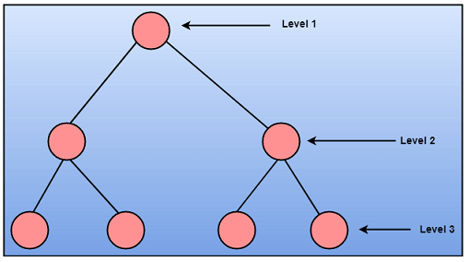
Top-down Approach:
This approach starts with the identification of the main components and then decomposing them into their more detailed sub-components.

Slide 24
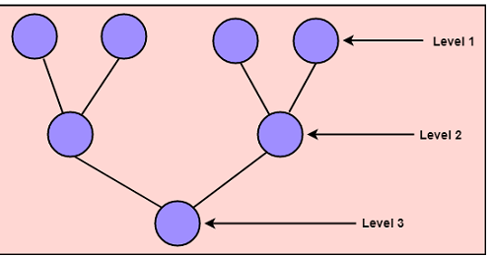
Bottom-up Approach
A bottom-up approach begins with the lower details and moves towards up the hierarchy, as shown in fig. This approach is suitable in case of an existing system.

Slide 25
Coupling and Cohesion
Module Coupling
The coupling is the degree of interdependence between software modules.
Two modules that are tightly coupled are strongly dependent on each other.
two modules that are loosely coupled are not dependent on each other.
Uncoupled modules have no interdependence at all within them.

Slide 26
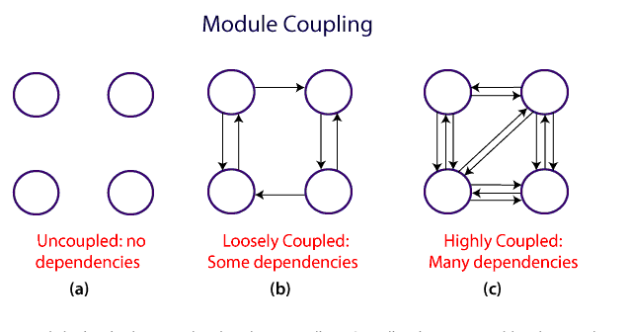
coupling techniques

Slide 27
A good design is the one that has low coupling.
Coupling is measured by the number of relations between the modules.
coupling increases as the number of calls between modules increase or the amount of shared data is large.
Thus, it can be said that a design with high coupling will have more errors

Slide 28
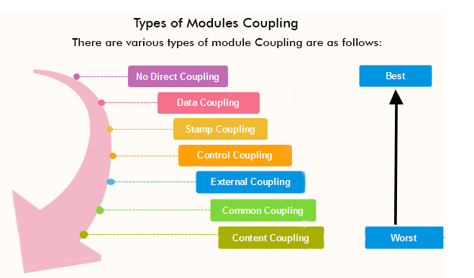

Slide 29
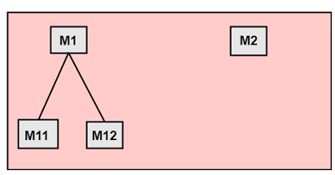
No Direct Coupling: There is no direct coupling between M1 and M2.

Slide 30
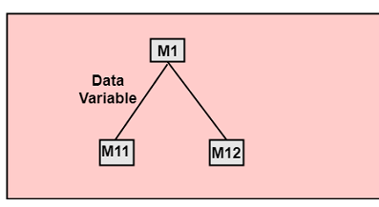
2. Data Coupling: When data of one module is passed to another module, this is called data coupling.

Slide 31
3. Stamp Coupling:
Two modules are stamp coupled if they communicate using composite data items such as structure, objects, etc.
When the module passes non-global data structure or entire structure to another module, they are said to be stamp coupled. For example, passing structure variable in C or object in C++ language to a module.
When multiple modules share common data structure and work on different part of it, it is called stamp coupling.

Slide 32
4. Control Coupling:
Two modules are called control-coupled if one of them decides the function of the other module or changes its flow of execution.
5. External Coupling:
External Coupling arises when two modules share an externally imposed data, communication, or device interface. This is related to communication to external tools and devices.

Slide 33
6. Common Coupling:
Two modules are common coupled if they share information through some global data items.
7. Content Coupling:
Content Coupling exists among two modules if they share code, e.g., a branch from one module into another module.

Slide 34
Module Cohesion
Cohesion is a measure that defines the degree of intra-dependability within elements of a module. The greater the cohesion, the better is the program design.

Slide 35
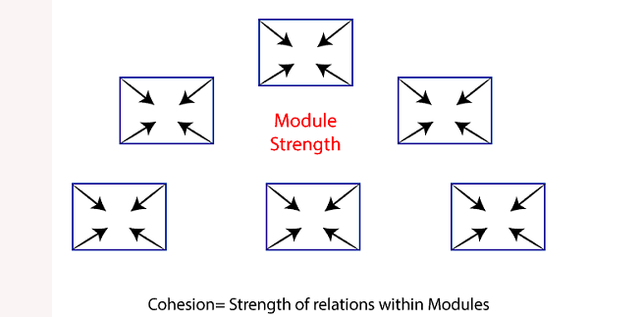

Slide 36
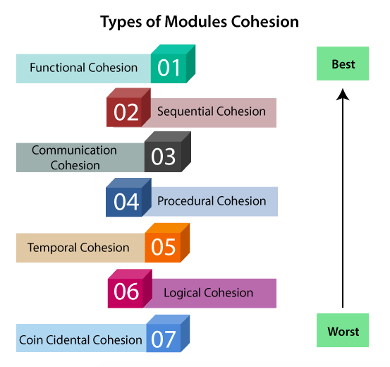

Slide 37
Functional Cohesion:
Functional Cohesion is said to exist if the different elements of a module, cooperate to achieve a single function.
Sequential Cohesion:
When elements of module are grouped because the output of one element serves as input to another and so on, it is called sequential cohesion.

Slide 38
Communicational Cohesion:
When elements of module are grouped together, which are executed sequentially and work on same data (information), it is called communicational cohesion.
Procedural Cohesion:
When elements of module are grouped together, which are executed sequentially in order to perform a task, it is called procedural cohesion.

Slide 39
Temporal Cohesion:
When elements of module are organized such that they are processed at a similar point in time, it is called temporal cohesion
Logical Cohesion:
A module is said to be logically cohesive if all the elements of the module perform a similar operation. For example Error handling, data input and data output, etc.

Slide 40
Coincidental Cohesion: A module is said to have coincidental cohesion if it performs a set of tasks that are associated with each other very loosely, if at all.
It is unplanned and random cohesion, which might be the result of breaking the program into smaller modules for the sake of modularization.
Because it is unplanned, it may serve confusion to the programmers and is generally not-accepted.

